Slide 1

Smart Courier Tracking and Delivery
Route Management Platform
GUIDED BY :
DR . SIVASANKAR
PRESENTED BY :
HEMA PRIYA T
SUBIKSHA U
BAGYA VENKATESH

Slide 2


Review 1 Feedback
Progress After Review 1
Refined the overall system architecture.
Separated the system into three independent modules.
Designed the structure and functionality of the Delivery Dashboard.
Defined the flow of shipment information through the system.
Prepared the initial Use Case and Class Diagram structure.
Identified the major database tables and their relationships.
Defined the Java-based implementation environment.
Current Stage
Detailed System Design → Module Development → Database Integration

Slide 3
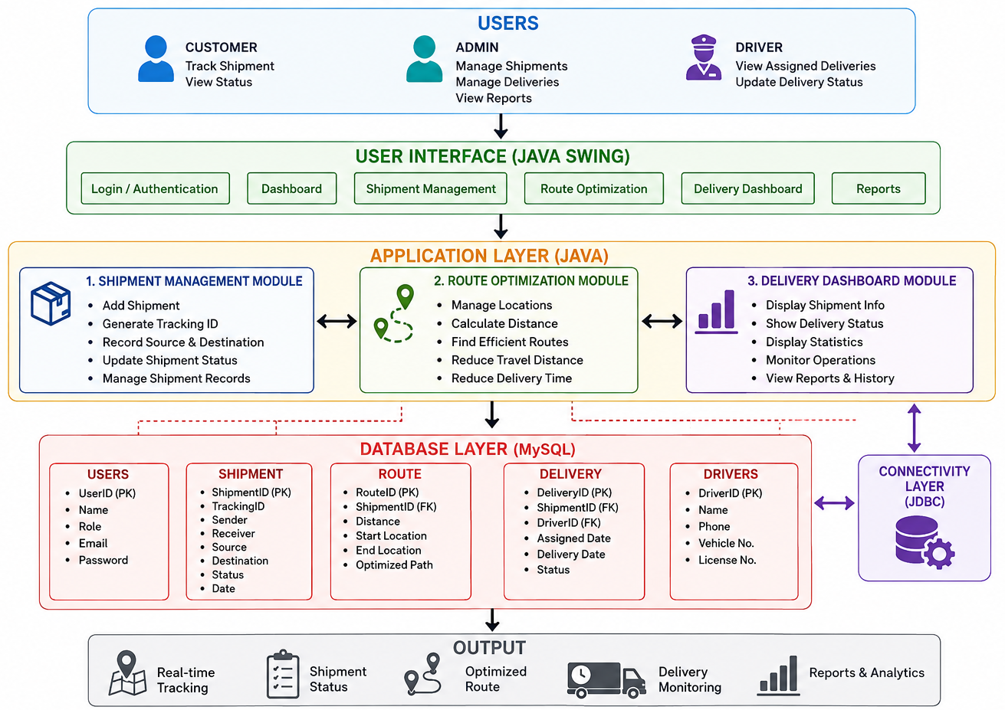
Architecture diagram

Slide 4
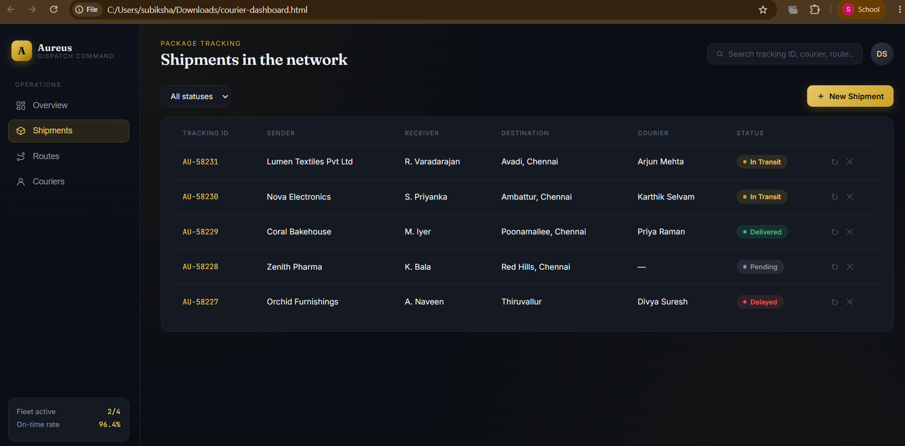
MODULE 1:Shipment Management Module
Purpose
The Shipment Management Module is responsible for creating, storing, updating, and retrieving all shipment-related information throughout the delivery process.
Main Functions
Shipment Creation: Allows the user or administrator to enter new shipment details.
Tracking ID Generation: Generates a unique identification number for every shipment.
Customer Details: Stores sender and receiver information.
Location Management: Records pickup and destination locations.
Shipment Status: Maintains statuses such as Pending, In Transit, and Delivered.
Shipment Updates: Allows authorized users to update shipment information.
Record Management: Retrieves and maintains previous shipment records.
Process
Enter Shipment Details → Generate Tracking ID → Store in Database → Update Shipment Status

Slide 5
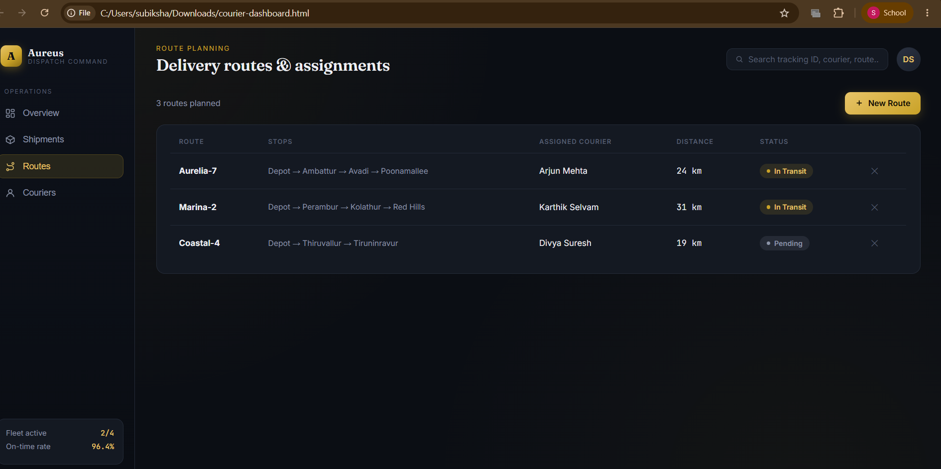
MODULE 2:Route Optimization Module
Purpose
The Route Optimization Module is responsible for identifying an efficient route between the pickup location and destination to improve delivery efficiency.
Main Functions
Location Input: Accepts pickup and destination locations.
Distance Calculation: Determines the distance between delivery points.
Route Planning: Generates possible delivery paths.
Efficient Route Selection: Selects a suitable route based on distance and delivery requirements.
Travel Reduction: Helps reduce unnecessary travel distance.
Time Reduction: Supports faster delivery by selecting efficient routes.
Delivery Planning: Provides route information for delivery assignment.
Process
Pickup Location + Destination → Route Calculation → Route Selection → Delivery Assignment

Slide 6
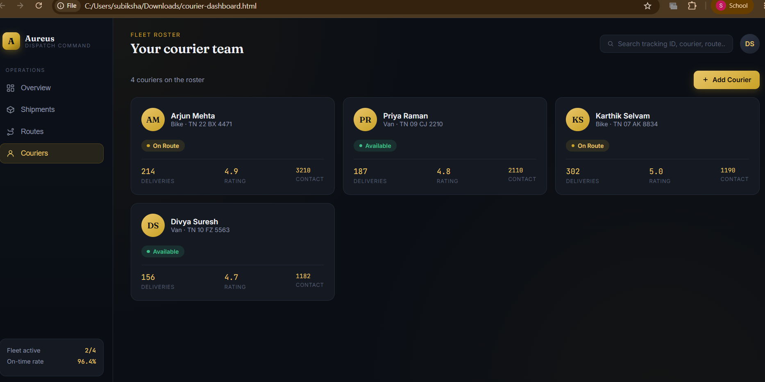
MODULE 3:Delivery Dashboard Module
Purpose
The Delivery Dashboard provides a centralized interface for monitoring shipments, delivery progress, and overall courier operations.
Main Functions
Shipment Overview: Displays the total number of shipments.
Status Monitoring: Shows Pending, In Transit, and Delivered shipments.
Delivery Statistics: Provides summarized information about current deliveries.
Shipment Tracking: Displays the latest status of individual shipments.
Operational Monitoring: Helps administrators monitor delivery activities.
History Management: Provides access to previous shipment and delivery records.
Centralized View: Combines important delivery information in one interface.
Dashboard Indicators
Total Shipments | Pending | In Transit | Delivered

Slide 7
IMPLEMENTATION
Implementation Modules
Login
User enters username and password.
System validates the login.
Successful login opens dashboard.
Shipment
Create shipment.
Generate tracking ID.
Store shipment details.
Update delivery status.
Courier
Add courier.
Store vehicle details.
Assign courier to shipment.
Route
Create route.
Add destinations.
Assign courier.
Store route details.
Database
Data can be inserted, updated, deleted and retrieved.
Completion
Approximately 60% of the core system is completed.

Slide 8
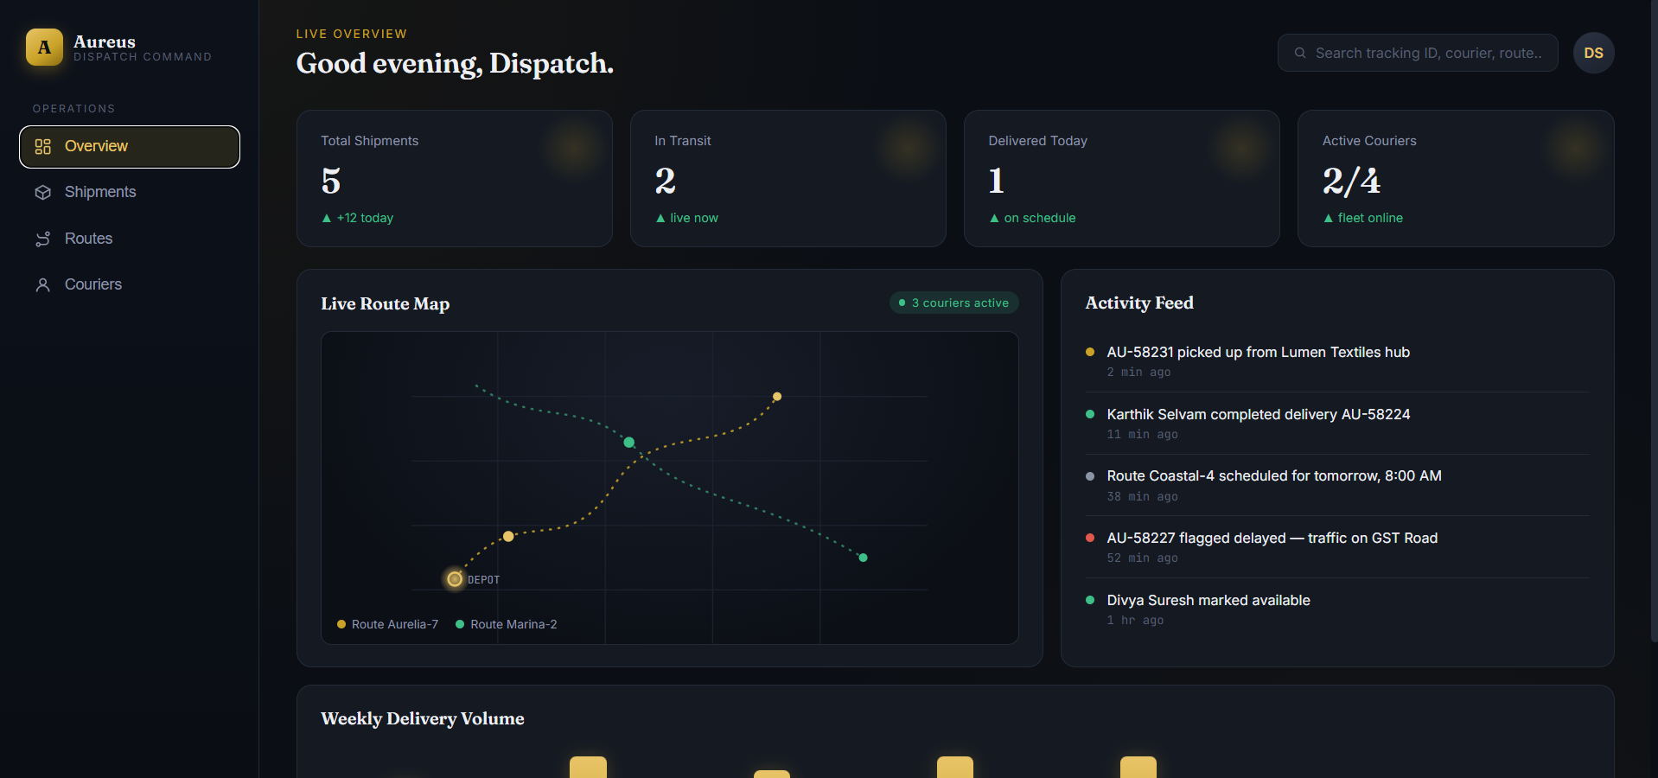
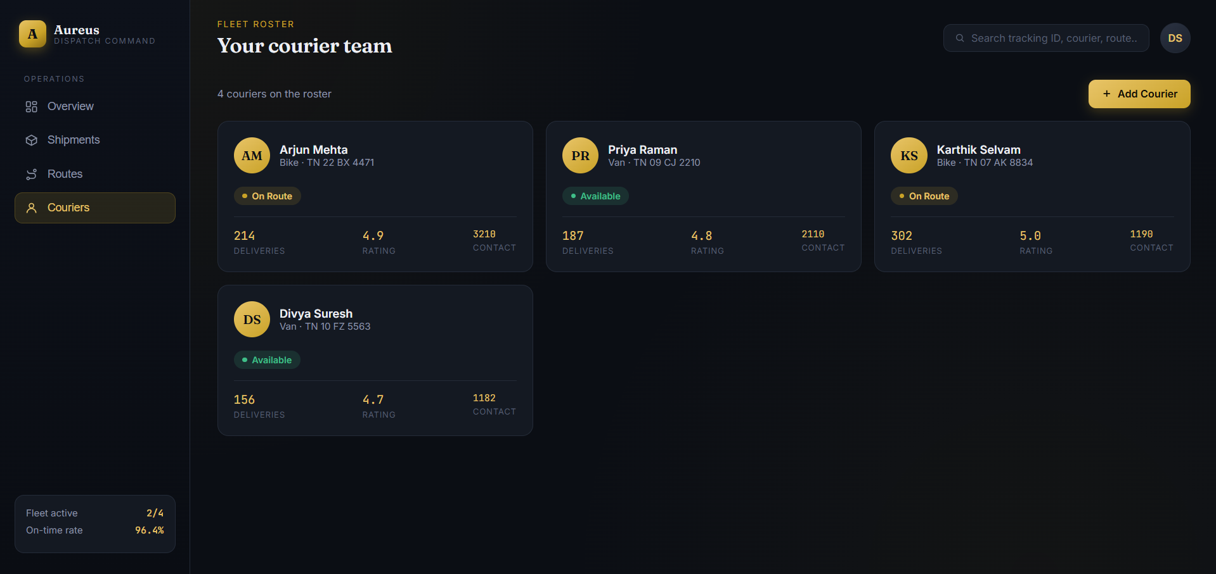
RESULTS

Slide 9
CHALLENGES
Issues
Managing data flow between the three modules
Maintaining accurate shipment status
Handling multiple shipment records efficiently
Designing a simple and user-friendly dashboard
Ensuring consistent data between the application and database
Solutions
Used separate modules with defined responsibilities
Added structured shipment status management
Designed organized database tables
Created a centralized dashboard
Used JDBC for reliable Java–MySQL communication

Slide 10
THANK YOU!!

